Slide 1
Java Spring · Week 2
Logs, and who
builds your objects
logback · the Spring context · beans
Eng. Mohamed Shehab
Faculty of Computers and Information, Menoufia University

Slide 2
Where we stopped last week
You pick the level. A file picks the threshold.
In your code | In logback.xml
log.debug("...") | <root level="INFO">
You choose a level for every single line, while you write it. | You choose one threshold for the whole application, at run time.
Changing it means editing code, building, and deploying. | Changing it means editing a file and restarting. No build.
Today we finish the job: how to write the line itself, and where to put it.
Java Spring · Week 2 · 02

Slide 3
The one habit worth building today
Braces, not plus
Do this
Not this
log.debug("{} seats left for {}",
available, event);
log.debug(available +
" seats left for " + event);
The string is built inside the library, and only if the level is on.
Java builds the string first, then hands it to a method that may throw it away.
With DEBUG off and a million rows: zero strings built, or a million built and binned.
Java Spring · Week 2 · 03

Slide 4
Two mistakes that cost you hours later
Logging a failure
log.error("could not send confirmation for {}", event, e);
The rule | Why
The exception goes last, with no brace of its own | SLF4J works that out by itself and prints the whole stack trace
Never e.getMessage() on its own | You learn that something failed, never which file and which line
A refused request is warn, not error | If everything is an error, a real error stops meaning anything
Java Spring · Week 2 · 04

Slide 5
In a real project you never open DEBUG on everything
Turn it up for your code only
<logger name="org.example" level="DEBUG"/>
<root level="WARN"/>
Your classes talk. Hibernate, Tomcat and Spring stay quiet.
Level | Put one here
info | A booking went through. A job started. Something a human may ask about later.
warn | A retry, a cache miss, a fallback. It worked, but not the way you planned.
error | This request died. Always with the exception attached.
Java Spring · Week 2 · 05

Slide 6
The line you just typed, and one word that writes it for you
An annotation is a note stuck on your code
You wrote this
Delete it, write this instead
private static final Logger log =
LoggerFactory.getLogger(Main.class);
@Slf4j
public class Main { ... }
javap -p target/classes/org/example/Main.class
public class org.example.Main {
private static final org.slf4j.Logger log; ← still there
}
Gone from your file, present in the compiled one. Something read the word and wrote the line.
@Override
@Test
@Entity
@Component
the compiler
JUnit
Hibernate
Spring, in a moment
Java Spring · Week 2 · 06

Slide 7
One word wrote one line. Here is one that writes ten methods.
Same idea, bigger payoff
@Data // three fields, zero methods
public class Booking { ... }
@Getter @Setter
@Data
six methods appear: three getters, three setters
those six, plus toString, equals, hashCode and canEqual
// with @Getter @Setter
the booking: org.example.Booking@45e5696d
// with @Data
the booking: Booking(user=ahmed@example.com, eventTitle=Spring Boot Workshop, seats=5)
Java Spring · Week 2 · 07

Slide 8
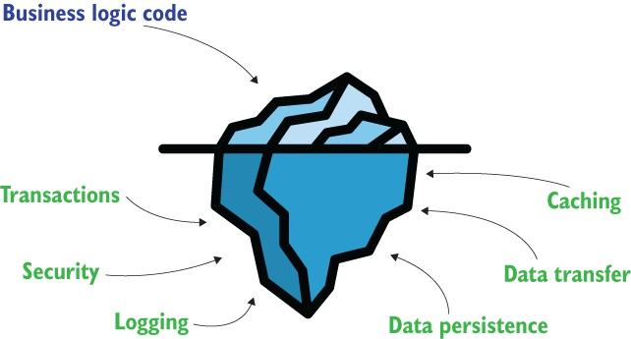
Chapter 1 · before any Spring code, why a framework exists at all
The part nobody sees is the bigger part
figure 1.2 · Spring Start Here, Laurentiu Spilca, Manning Publications
You spent the last hour on one item under the water. Every app needs all of them, and none of them is your product.
Java Spring · Week 2 · 08

Slide 9
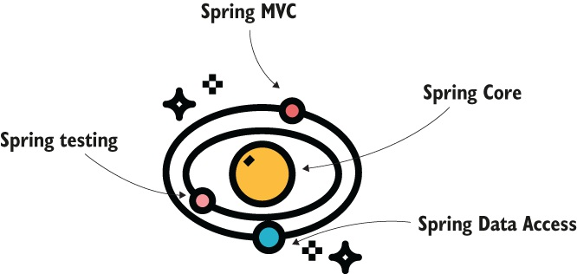
Chapter 1 · and this is why nobody knows all of Spring
Spring is not a framework. It is an ecosystem of them.
figure 1.3 · Spring Start Here, Laurentiu Spilca, Manning Publications
Inside the Spring framework | What it is for
Spring Core | the context, aspects, the foundations. today
Spring MVC | web apps that answer HTTP
Spring Data Access | JDBC, ORM, transactions
Spring testing | tools for writing tests
and whole projects around it | Spring Boot, Spring Security, Spring Cloud, Spring Batch, and more
Java Spring · Week 2 · 09

Slide 10
Out of all of that, here is our term
Where this section sits
The piece | Where it shows up | Week
Spring Core · the context | beans, wiring, scopes, the container | 2 and 3 · here
Spring Boot | convention over configuration | 4
Spring MVC | REST controllers, validation, layers | 5 and 6
Spring Data | JPA, relations, transactions, queries | 7 to 9
the wider ecosystem | Redis, then RabbitMQ | 10 and 11
Spring testing | tests, and Docker alongside them | 12
Spring Core · aspects | chapter 6 of the book | not in this course
It is built on top of itself. If today is unclear, everything after it is unclear.
Java Spring · Week 2 · 10

Slide 11
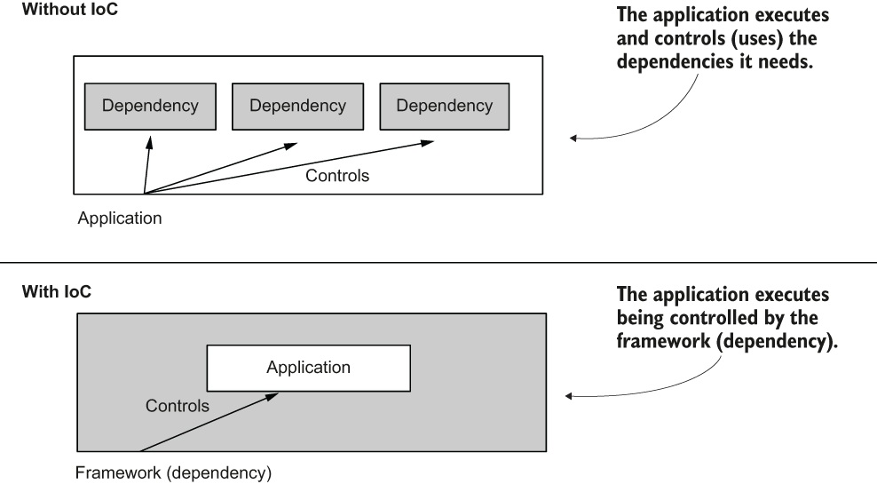
Chapter 1 · section 1.4, the part most courses skip
And when not to use one
The app has to stay tiny, like a serverless function
Security rules say custom code only
You would customise it more than you would write without it
The app already works and you gain nothing
figure 1.4 · Spring Start Here, Laurentiu Spilca, Manning Publications
Nothing fits every case. Next: the one idea in that second picture.
Java Spring · Week 2 · 11

Slide 12
Week 1 · you wrote this yourself
Who writes new for you?
ObjectMapper mapper = new ObjectMapper();
One object, one line. Fine. Now the real thing:
new BookingService(
new SmtpEmailSender(
new MailConfig(host, port, user)))
Thirty services, in the right order, built once and shared. Someone has to own that job.
Java Spring · Week 2 · 12

Slide 13
Before anything goes in it, you need the box
The Spring context
var context = new AnnotationConfigApplicationContext(AppConfig.class);
Annotation
Config
ApplicationContext
the configuration comes from notes on classes, not from an XML file
and the class holding those notes is AppConfig
the box itself. One object that holds your objects
From week 4, Spring Boot writes this line for you. You will not see it again, so look at it now.
Java Spring · Week 2 · 13

Slide 14
config/AppConfig.java · one note on it, and nothing inside
And it starts empty
@Configuration
public class AppConfig {
}
beans in the context: 5
getBean(Event.class) -> No qualifying bean of type
'com.eventia.model.Event' available
new Event(1L, "my own event", 10);
beans in the context: 5 ← it did not move
Four of those five are Spring's own. The fifth is AppConfig itself: a configuration class is a bean too.
Java Spring · Week 2 · 14

Slide 15
2.1 in the book · one method, one note on it
You put the first one in yourself
@Bean
public Event workshop() {
return new Event(1L, "Spring Boot Workshop", 40);
}
beans in the context: 6 ← was 5
appConfig
workshop ← the method name
got it: Spring Boot Workshop with 40 seats
Java Spring · Week 2 · 15

Slide 16
You wrote a method. You never call it.
What Spring did with it
1
2
3
It called your method
It kept what came back
It named it after the method
once, while the context was starting up
that object now lives in the box
workshop, not Event
@Data // Lombok, the one you just met
public class Event { ... } // and not one Spring annotation
a service
a repository
an email sender
a JSON mapper
the booking logic
the thing that talks to the database
one connection, shared
one shared, set up once
Java Spring · Week 2 · 16

Slide 17
Ask them before you run it: which one comes back?
Two of them. Spring stops.
@Bean
public Event conference() {
return new Event(2L, "Java Conference", 200);
}
beans in the context: 7
getBean(Event.class) ->
No qualifying bean of type 'com.eventia.model.Event' available:
expected single matching bean but found 2: workshop,conference
It will not guess. A silently wrong answer is worse than a stop.
Java Spring · Week 2 · 17

Slide 18
The first way out: say which one
Ask for it by name
context.getBean("workshop", Event.class); // Spring Boot Workshop
context.getBean("conference", Event.class); // Java Conference
And the name is just the method name, so you can change it.
@Bean("mainEvent")
public Event workshop() { ... }
mainEvent ← the method name is gone
conference
getBean("workshop") -> No bean named 'workshop' available
Java Spring · Week 2 · 18

Slide 19
The second way out: do not say the name at all
Mark one as the default
@Bean
@Primary
public Event workshop() {
return new Event(1L, "Spring Boot Workshop", 40);
}
getBean(Event.class) now works -> Spring Boot Workshop
by name
@Primary
you decide every time you ask, in the asking code
you decide once in the config, and callers need not know there was a choice
Java Spring · Week 2 · 19

Slide 20
Clock belongs to the JDK. You cannot write a note on it.
The classes that are not yours
@Bean
public Clock clock() {
return Clock.systemUTC();
}
beans in the context: 8 ← was 7
clock ← the method name again
got a class I do not own: java.time.Clock$SystemClock
a DataSource
an HTTP client
ObjectMapper
the database connection pool. Week 7
for calling another service
the one you used in week 1
Week 1 you wrote new ObjectMapper() by hand. Same problem, same door.
Java Spring · Week 2 · 20

Slide 21
Your own classes. Is there a shorter way?
Four methods became one word
what you had
what you write instead
@Bean
public Event workshop() {
return new Event(...);
}
@Bean
public Event conference() {
return new Event(...);
}
@Component
public class BookingService { ... }
@Configuration
@ComponentScan("com.eventia")
public class AppConfig {
}
Only for classes you own. Clock stays a @Bean, in the same config, next to this.
Java Spring · Week 2 · 21

Slide 22
None of them runs. Each one is data Spring looks for.
The notes Spring reads
The note | What Spring does when it reads it
@Component | build one object of this class and keep it
@ComponentScan | walk this package and find the notes yourself
@Service | the same as @Component, with a label on it
// Service.class.getAnnotations(), measured
@Target({TYPE})
@Retention(RUNTIME)
@Documented()
@Component("") ← @Service IS a @Component
Java Spring · Week 2 · 22

Slide 23
config/AppConfig.java · the @Bean methods are gone
You hand over no list
@Configuration
@ComponentScan(basePackages = "com.eventia")
public class AppConfig {
}
1
2
3
It opens the package
It looks at every class
It builds the ones there are
the one, and only the one, you named
is there a note on it, or not
and that is the whole trick
You said where to look. You never said what is in there. Add a class tomorrow and this file does not change.
Java Spring · Week 2 · 23

Slide 24
Two ways to break it, and they look the same from outside
Same message, two different causes
1 · take the note away
2 · keep it, look elsewhere
public class BookingService {
...
}
// the @Component line is gone
@ComponentScan(basePackages =
"com.other")
// the note is still on the class
No qualifying bean of type 'com.eventia.service.BookingService' available
One message. Twice. The note is not enough on its own: the class has to be where Spring is looking.
Java Spring · Week 2 · 24

Slide 25
The question that asks itself
Same box, two doors
@Bean | stereotype
@Bean on a method in the config | @Component on the class | where the note goes
a whole method per bean | one word | how much you write
yes | no | a class you do not own
yes | no | several of the same type
only when you must | everything else | what we use from here on
Java Spring · Week 2 · 25

Slide 26
Run it. Eight became six, and the code got shorter.
One word did what four methods did
INFO c.e.s.BookingService - ahmed@example.com booked a seat
INFO com.eventia.App - beans in the context: 6
INFO com.eventia.App - bean name: bookingService ← from the class name
INFO com.eventia.App - same instance? true
6 beans
bookingService
same instance
four are Spring's own, one is AppConfig, one is yours
the class name, not a method name. That is the last practical difference between the two doors
asked twice, got the same object. A singleton
Java Spring · Week 2 · 26

Slide 27
One log line inside the constructor, and three in App
Built before you asked
public BookingService() { log.info("constructor ran"); }
INFO com.eventia.App - building the context now
INFO c.e.s.BookingService - constructor ran
INFO com.eventia.App - context ready, I asked for nothing yet
INFO com.eventia.App - now I asked
INFO c.e.s.BookingService - ahmed@example.com booked a seat
line 2 beat line 3
and never again
Spring builds its singletons while the context starts, not when you ask
getBean built nothing. It looked one up.
Java Spring · Week 2 · 27

Slide 28
One thing we did not do today
Our service needed nothing
@Service
public class BookingService {
private final EmailSender emailSender;
BookingService(EmailSender emailSender) { ... }
Next week it needs an EmailSender, and Spring hands one in. That is dependency injection.
Java Spring · Week 2 · 28

Slide 29
Five things to take away
1
The level is chosen in the code. The threshold lives in a file outside it.
2
Braces, never plus. And the exception goes last, with no braces of its own.
3
error means something of mine is broken. A refused request is warn.
4
An annotation is data. Nothing happens until something reads it. Spring is that something.
5
You never wrote new. The container built it once and handed you the same instance.
Java Spring · Week 2 · 29

Slide 30
Next week
Dependency injection: Spring passes in what your service needs
Eng. Mohamed Shehab
Faculty of Computers and Information, Menoufia University
mohamed.shehab.fci@gmail.com

